Slide 1
Hoghton Tower
LO: To create a timeline

Slide 2
Warm-up
What questions can you make up about this picture? Use who, what, where, when, why, how.
Can you answer any of them by examining the picture or discussing possibilities with your talk partners?

Slide 3
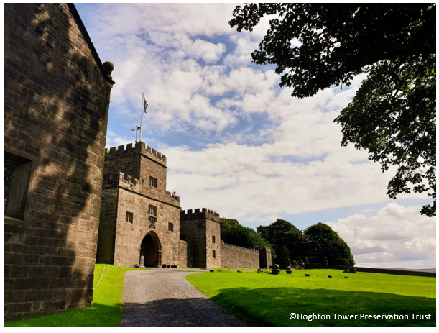
Timeline
Where is Hoghton Tower?
What is a timeline?
Can you discuss with your talk partner what you think a timeline is and give some examples.
Do you have a timeline in your classroom?

Slide 4
Create your Own Timeline
Can you create a timeline using the information about Hoghton Tower?

Slide 5
Who, What, Where, When, Why?
1. Who was in charge the longest at Hoghton Tower?
2. What were the 200 oaks used for in 1345 - 1385?
3. Why do you think the park was enlarged in 1386?
4. When did Thomas Hoghton go into exile? (What is exile?)
5. Where did Sir Gilbert Hoghton the 2nd Baronet, fortify?
6. Why do you think he fortified this place?
7. When was the restoration of Hoghton Tower started and by whom?
8. Who was granted the right to mine?

Slide 6
Choose one or two people or two things from your timeline and find three facts..
Research these on the internet.
Is the information easy to find?
Why do you think that is?
What could be done to improve this?

Slide 7
Plenary:
Talk with a partner;
What would you differently?
What did you enjoy?
What would you change?
What have your learnt?

