Slide 1
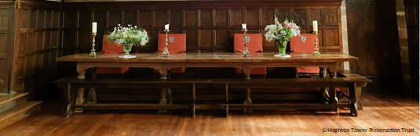
Food at Hoghton Tower 400 years ago

Slide 2

This is the layout of the tables at Hoghton Tower.
Who do you think would sit where and why?
What should be on the tables?
Top table
Think about who, what, where, when and how?
Talk with a talk partner.

Slide 3
Fruit & Vegetables
During Tudor and Stuart Times, it was difficult to store food so people ate fruit and vegetables that were in season.
Eat Seasonably
Find out more on this website:

Slide 4

Two courses
Two course meal at Hoghton Tower during the visit of King James I in 1617
There were two courses of all manner of flesh and fowl, including:
mutton
beef
veal
pig
venison
chickens
ducks
capons
boiled rabbit / fried rabbit / cold rabbit
pies of all kinds, mince, custard, buttered peas,
all coming pell-mell to the table
Do you eat any of these foods?
Where would you get these foods from?
Where do you think they would have got the foods from in 1617?
DISCUSS WITH A FRIEND.
What does pell-mell mean?
Confused or
disorderly manner meaning each course had a mixture of food.
geese
plover
partridge
quail
pheasant
turkey
turkey chicks
heron
Activity: see plan.

Slide 5
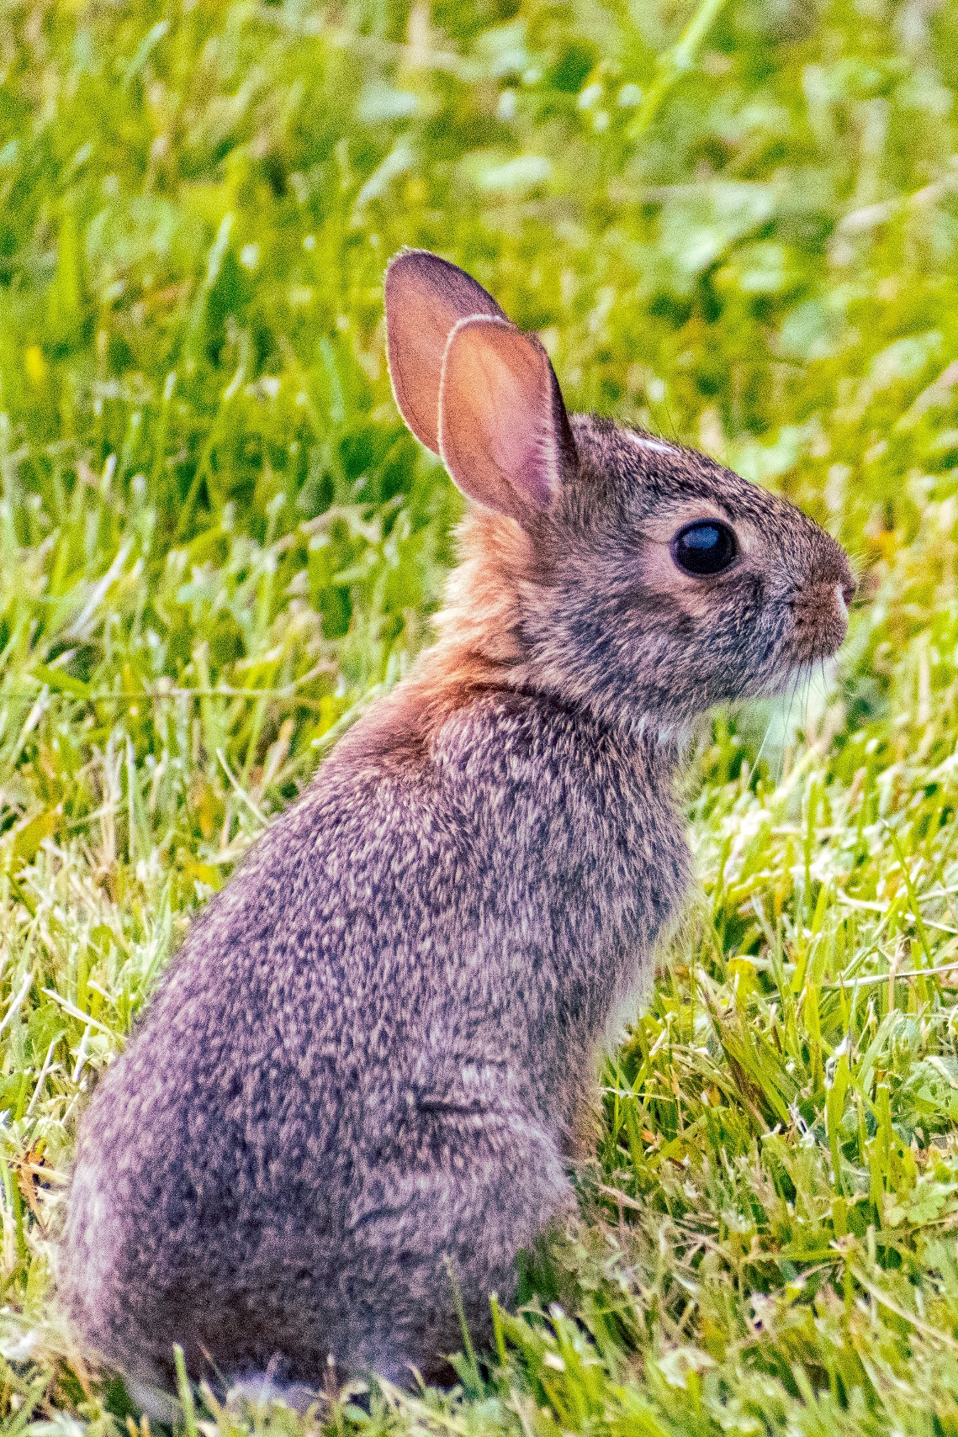
Different types of meat they would have eaten at Hoghton Tower 400 years ago.
Can you name any of them?
Would you see or eat any of them today?
Notes:
Photos – Rabbit Photo by Christopher Paul High on Unsplash

Slide 6
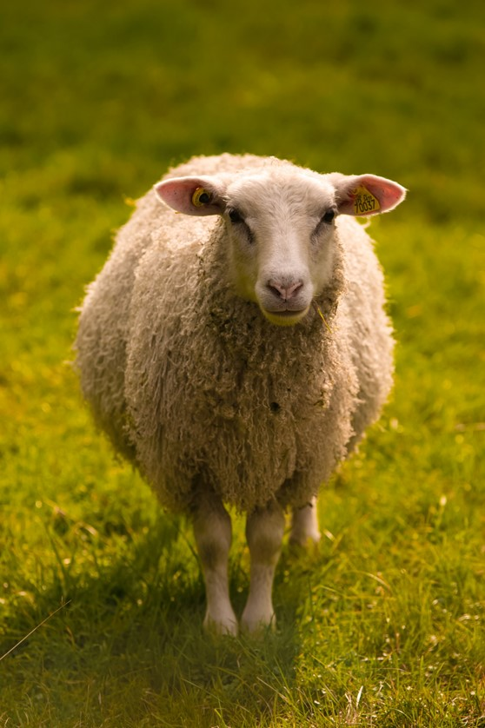
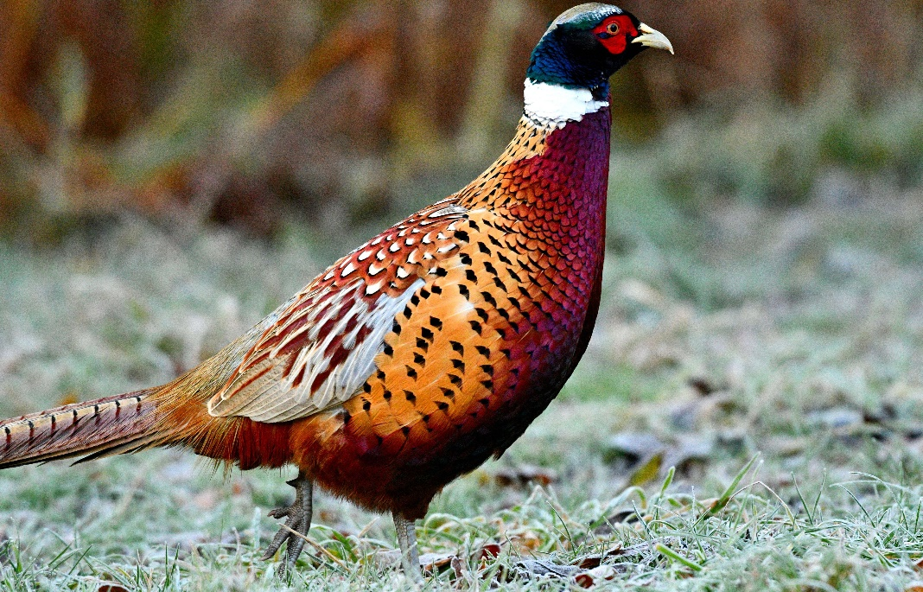
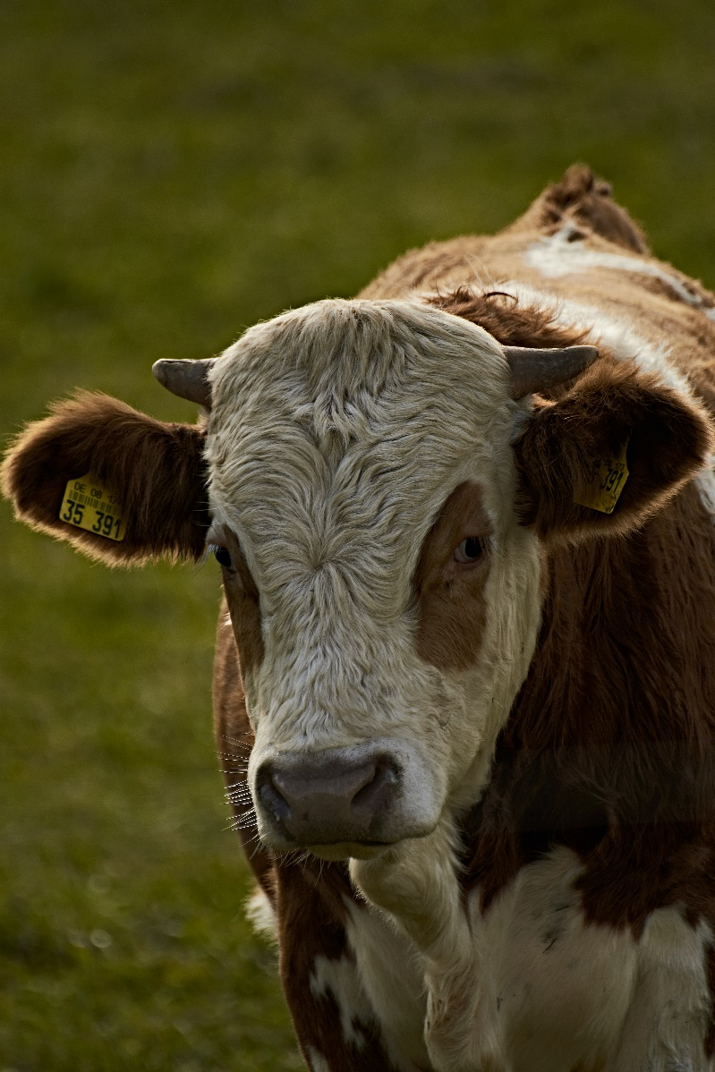
1
2
3
Notes:
Photo credits: 1. Sheep Photo by Benjamin Sander Bergum on Unsplash
2. Pheasant Photo by Robert Horobin on Unsplash
3. Cow Photo by Rolf Schmidbauer on Unsplash

Slide 7
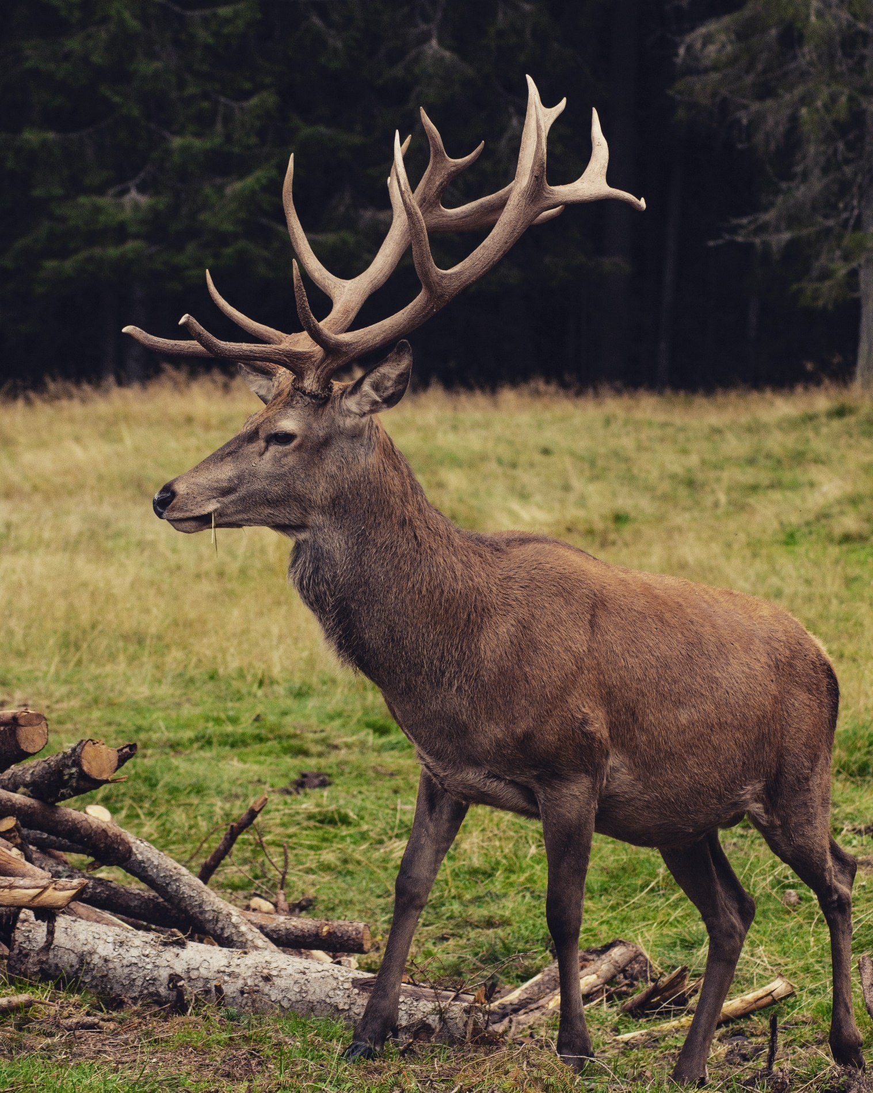
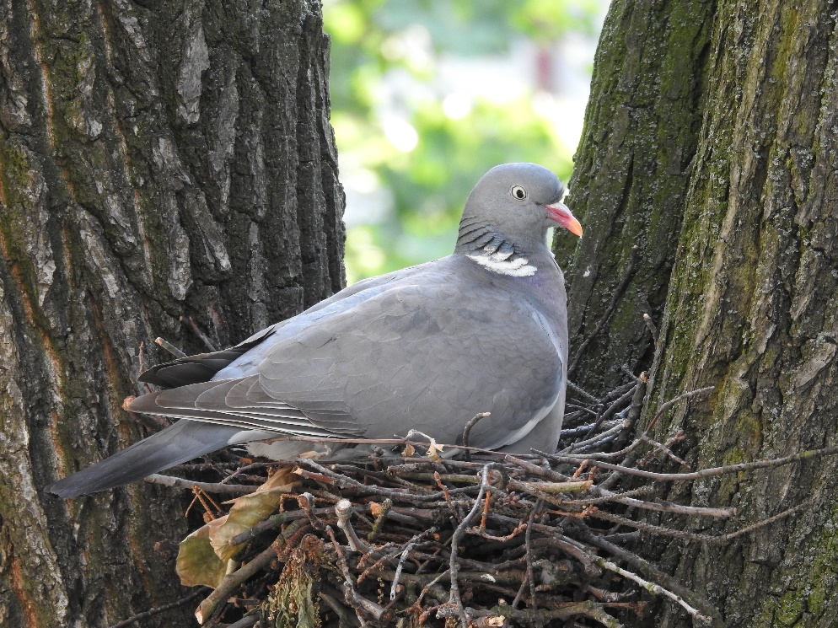
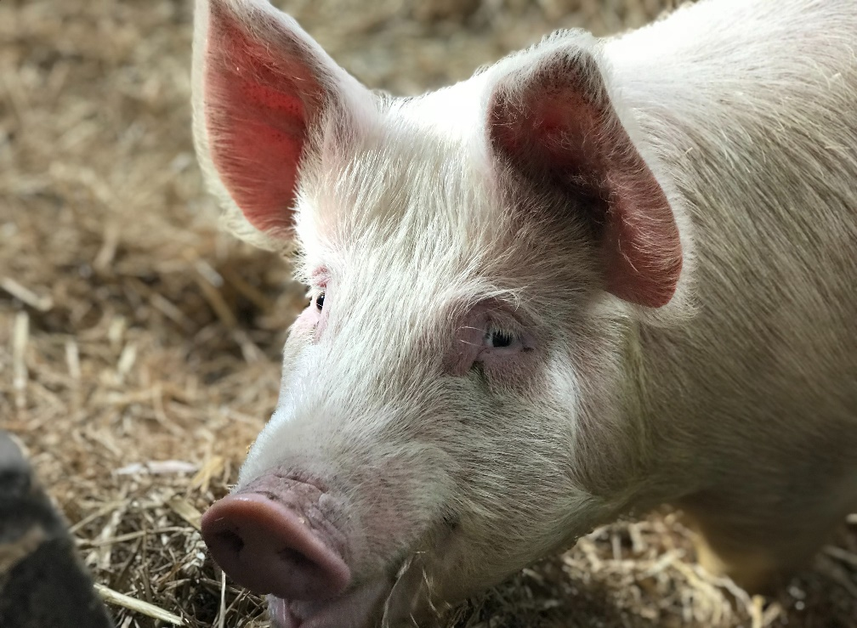
1
2
3
Notes:
Photo credits: 1. Deer Photo by Andrea Chioldin on Unsplash
2. Pigeon Photo by Lukáš Kadava on Unsplash
3. Pig Photo by Fi Jones on Unsplash

Slide 8
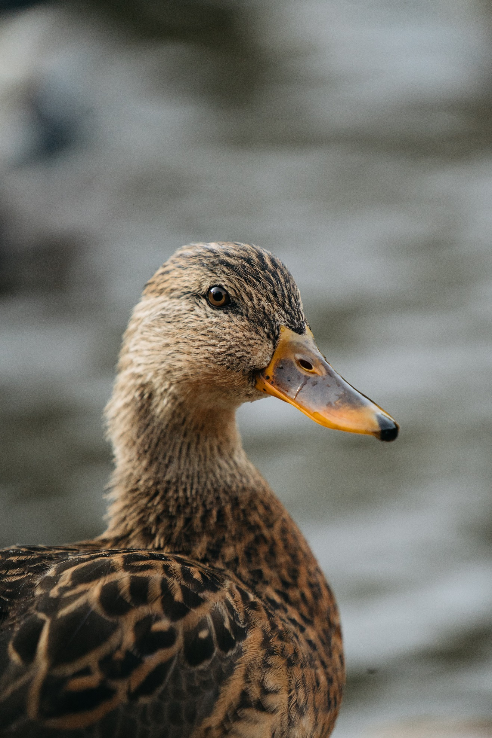
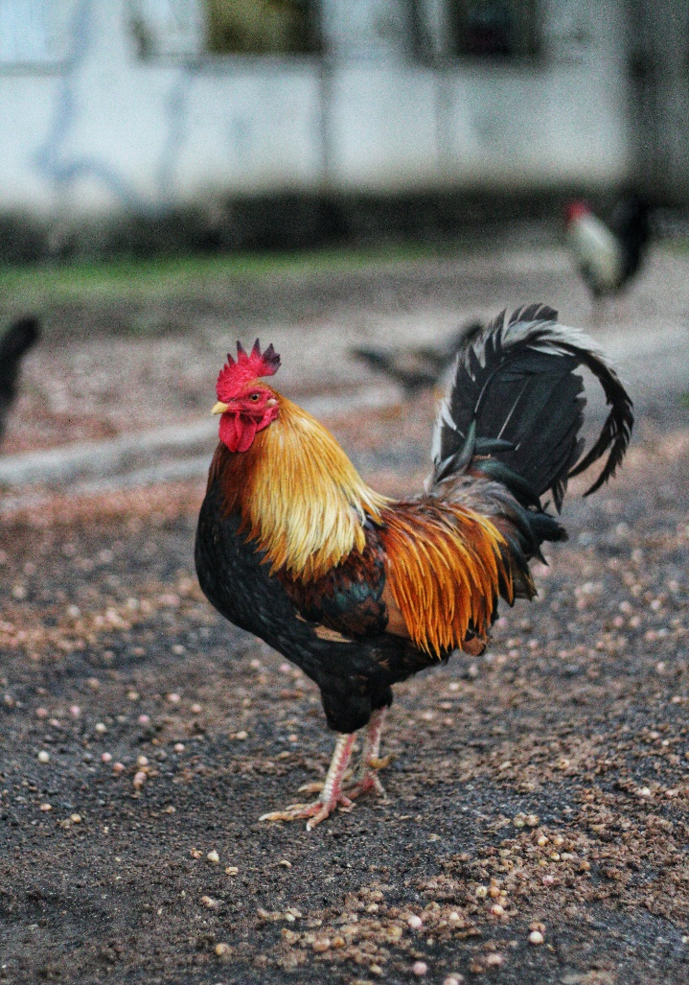
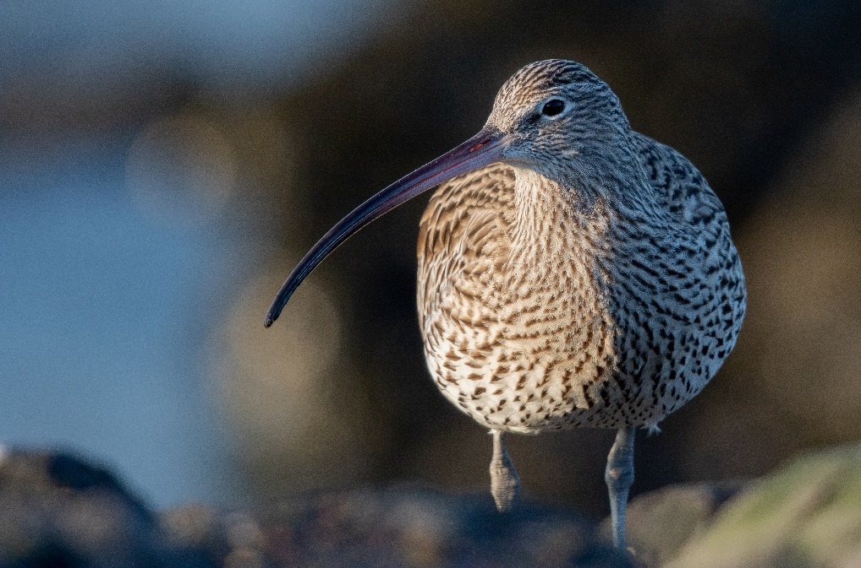
1
2
3
Notes:
Photo credits: 1. Duck Photo by Björn Antonissen on Unsplash
2. Capon (Cockerel) Photo by David Cain on Unsplash
3. Curlew https://www.freepik.com/photos/nature Nature photo created by wirestock - www.freepik.com

Slide 9
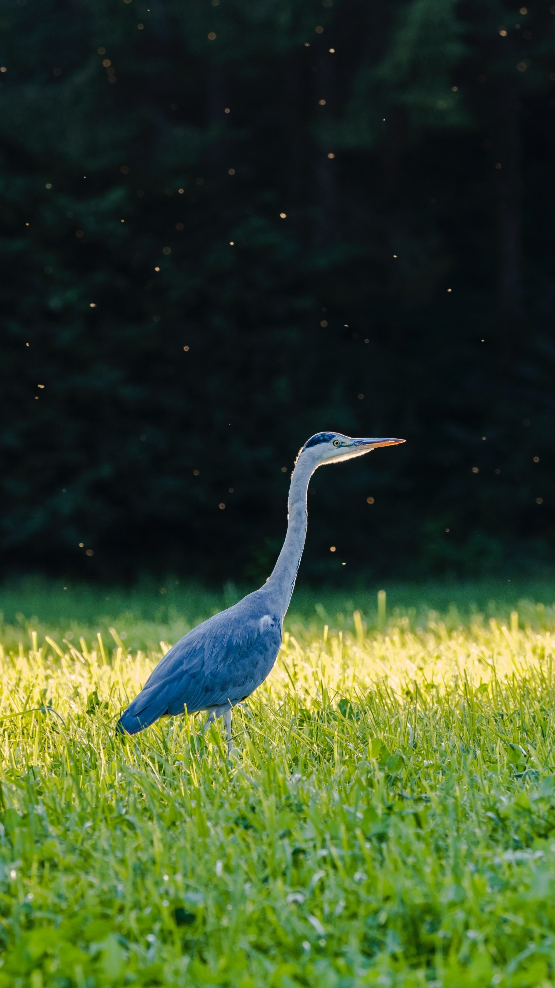
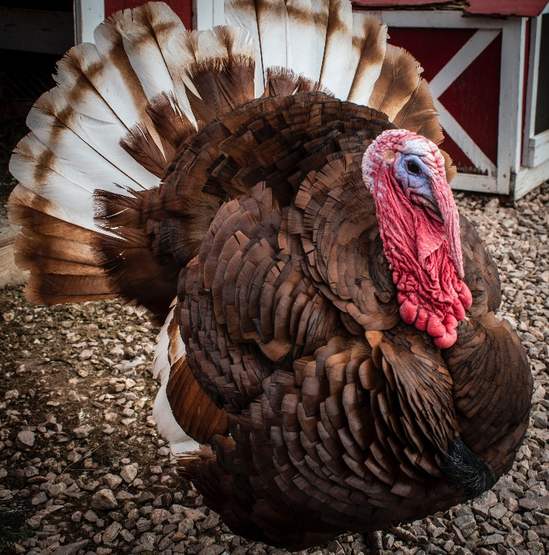
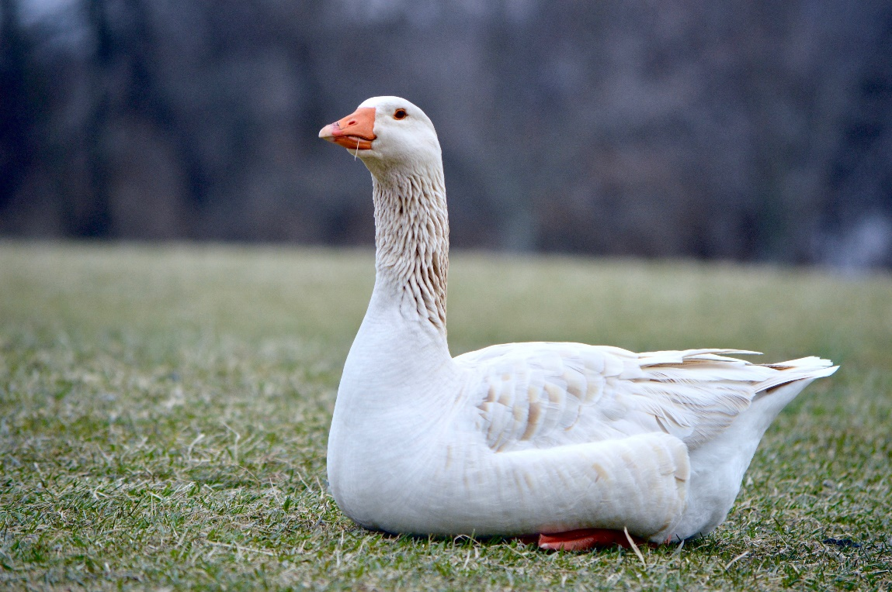
1
2
3
Notes:
Photo credits: 1. Heron Photo by Hansjörg Keller on Unsplash
2. Turkey Photo by Jon Sailer on Unsplash
3. Goose Photo by Carter Caroline on Unsplash

Slide 10
Plenary
What would you notice was different?
What did you like?
Which foods are similar to those you eat and which are different?

